Slide 1
Definition of Optimization
Day3 _ Objective
Linear Programming Model
Optimization using Excel
Optimization using Matlab

Slide 2
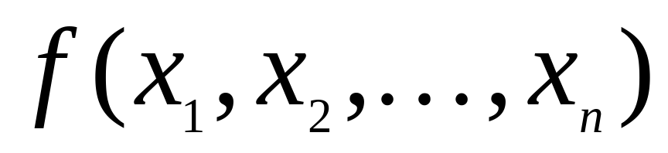
Optimization is the mathematical discipline which is concerned with finding the maximum (profit) and minimum(cost) of functions, possibly subject to constraints.
We use optimization in Economics, Architecture, structure design, Electrical circuits, .. etc.
What do we optimize?

Slide 3
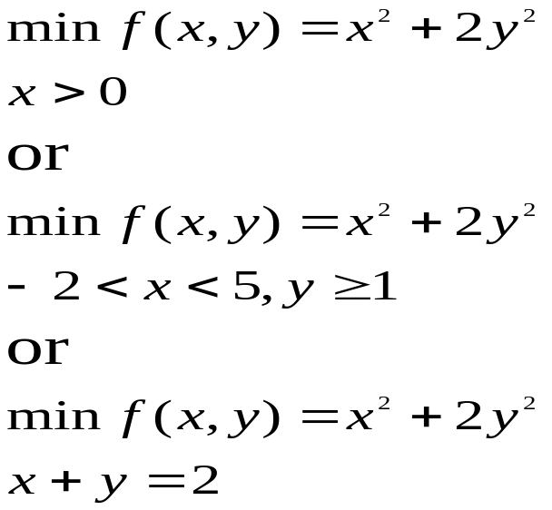
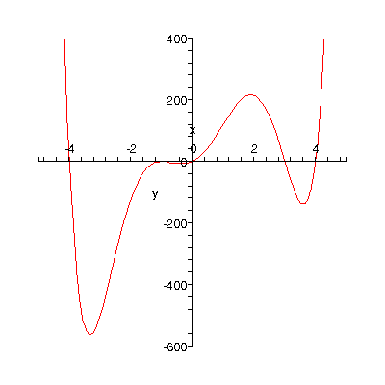
We use local max or local min by f’(x)=0 and
f”(x) > 0 if local min
f”(x) < 0 if local max
If the objective function and all constraints are linear functions of the decision variables (e.g., no squared terms, trigonometric functions, ratios of variables), then the problem is called a Linear Programming (LP) problem.

Slide 4
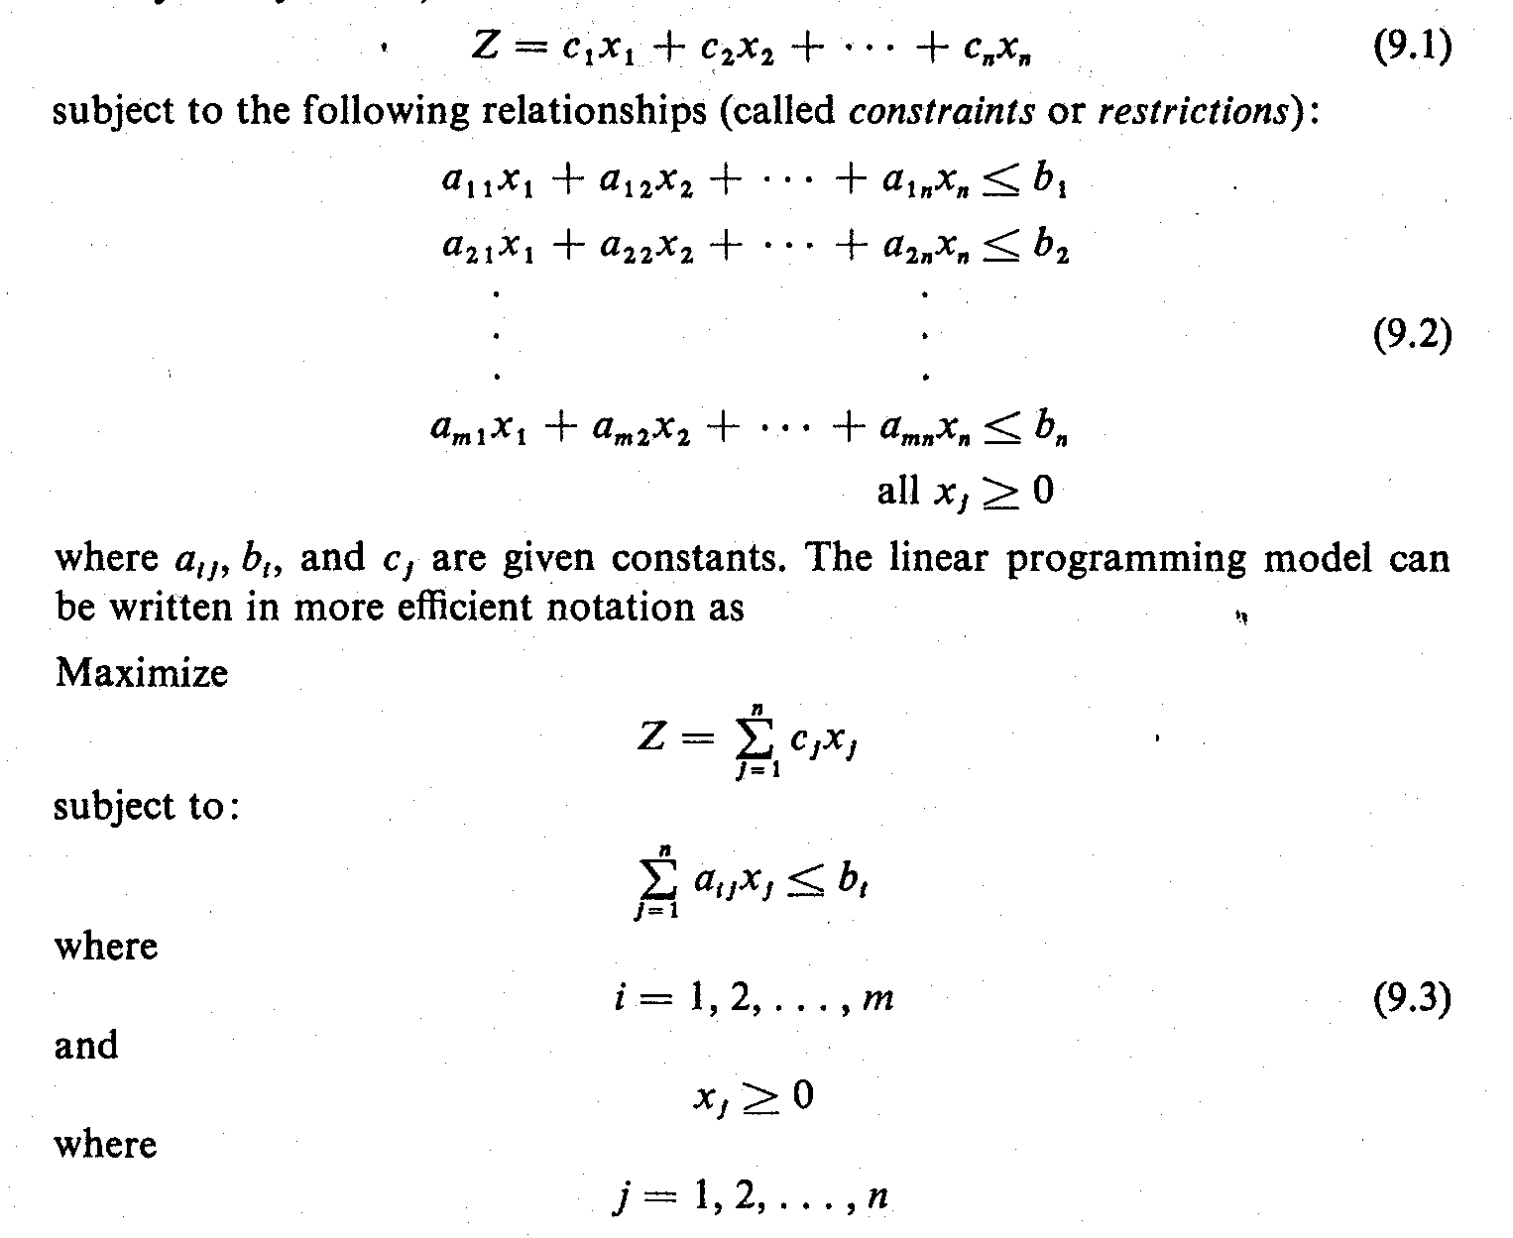
The Linear Programming Model
Let: x₁, x₂, x₃, ………, x_{n} = decision variables
    Z = Objective function or linear function
Objective: Maximize Z = c₁x₁ + c₂x₂ + c₃x₃ + ………+ c_{n}x_{n}
  subject to the following constraints:
  where a_{ij}, b_{i}, and c_{j} are given constants.

Slide 5
The Linear Programming Model
In more efficient notation:
The decision variables, x_{I}, x₂, ..., x_{n}, represent levels of n competing activities.

Slide 6
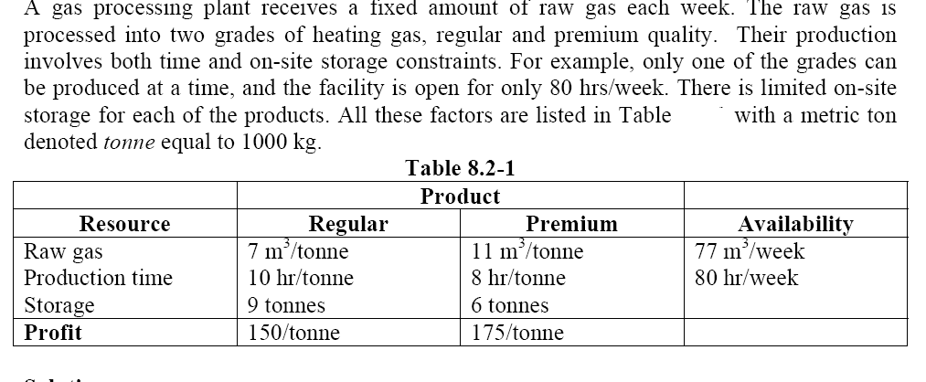
EXAMPLE: Gas Processing Problem
(Chemical/Petroleum Engineering Problem)

Slide 7
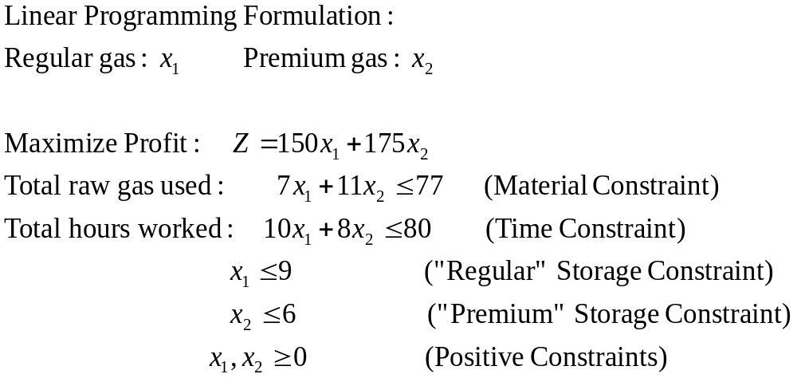
EXAMPLE: Gas Processing Problem
(Chemical/Petroleum Engineering Problem)
Company receives a fixed amount of raw gas each week.
Processes it to produce two grades of heating gas, regular and premium quality.
Each yields different profits, and involves different time and on-site storage constraints.
Objective: maximize profit without violating the material, time, and storage constraints
Solve using:
Graphical Method
Simplex Method
Excel solver (Simplex LP)

Slide 8
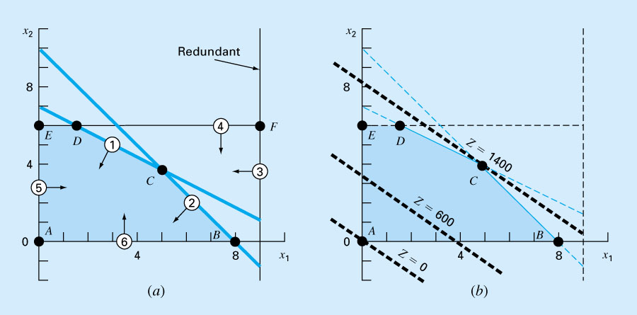
The optimal solution happens at the last corner of the feasible area of the objective line hit as it is moving toward its improvement
Optimal points (4.88,3.88)

Slide 9
The Simplex Method
It is applied by using computer programming by setting additional variables to calculate x1, x2 for max profit Z= 150 x1 + 175 x2
For x1<9 , x2<6
7 x1 + 11 x2 + A = 77
10 x1 + 8 x2 + B = 80
x1 + C =9
x2 + D =6
We have 4 equations and 6 unknown variables. We need to set each 2 variable to zero and find the other variables to calculate the profit :
 | x1 x2 | x1 A | x1 B | x1 C | X1 D | X2A | X2B | X2C | X2D | ..
x1 | 0 | 0 | 0 | 0 | 0
x2 | 0 |  |  |  |  | 0 | 0 | 0 | 0
A |  | 0 |  |  |  | 0 |  |  |  | 0
B |  |  | 0 |  |  |  | 0 |  |  | 0
C |  |  |  | 0 |  |  |  | 0
D |  |  |  |  | 0 |  |  |  | 0
Z

Slide 10
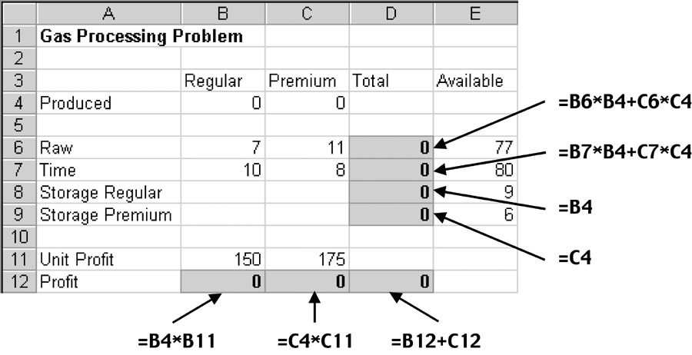
Excel Solution
Gas Processing Problem
*Write down the equations on the Excel Sheet.
*Demonstrate how to use the solver in Excel

Slide 11
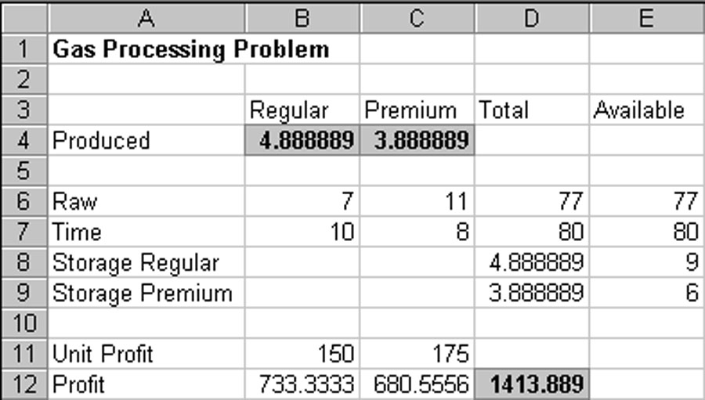

Slide 12
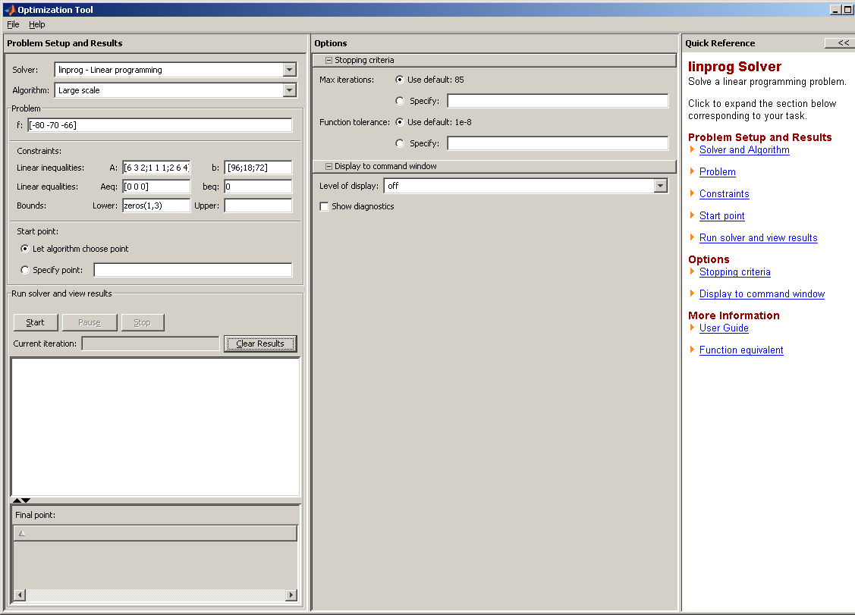
MATLAB --- using opimtool command

Slide 13
Example:
Suppose a company manufactures two products, A and B, which can be sold for $120 per unit and $80 per unit respectively. Management requires that at least 1000 units be manufactured each month. Product A requires five hours of labor per unit, and product B requires three hours per unit. The cost of labor is $12 per hour, and a total of 8000 hours are available per month. Determine a monthly production schedule that will maximize the company’s profit.

Slide 14
Here is the set-up to the problem:
Definitions of variables:
Let x = the number of units of product A manufactured per month
y = “ “ “ “ “ “ B “ “ “
Objective function:
Maximize P (profit) = (120 – 5*12)x + (80 – 3*12)y = 60x + 44y
Non-negative constraint:
x, y > 0
Problem constraints: x + y > 1000 units manufactured per month
5x + 3y < 8000 labor hours available per month

